Slide 1
Spark ML Algorithms
By Imran Ahmad (PhD)
Cloudanum Inc
imran@cloudanum.com

Slide 2
Introduction
Spark ML has rich library of open-source state-of-the-art Classification, Regression, Clustering and Collaborative Filtering Algorithms.
Model generators have been implemented as Estimators which accept training data as a DataFrame and implements fit() function that will produce the model.
All algorithms have inherent Spark-based horizontal scaling both in the compute and data dimensions. Thus, they can be used for BigData as opposed to tradition Python based scikit-learn ML library

Slide 3
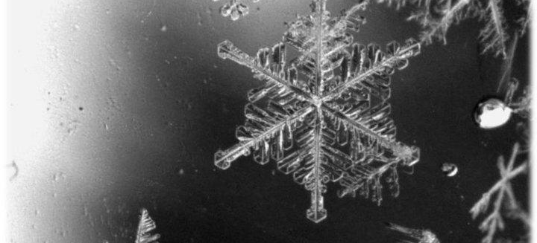
Trees based Algorithms
Main concepts

Slide 4
Introduction
The spark.ml implementation supports decision trees for binary and multiclass classification and for regression,
The can effectively use both continuous and categorical features.
The implementation partitions data by rows, allowing distributed training with millions or even billions of instances.

Slide 5
Decision Trees
Decision trees and their ensembles are popular methods for the machine learning tasks of classification and regression. Decision trees are widely used since they are easy to interpret, handle categorical features, extend to the multiclass classification setting, do not require feature scaling, and are able to capture non-linearities and feature interactions.
Full Support for ML Pipelines
Two types: Classification vs. Regression Decision Trees
Can use DataFrame metadata to distinguish continuous and categorical features

Slide 6
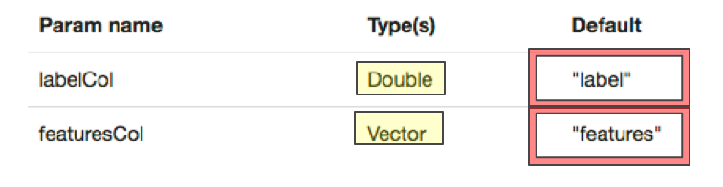
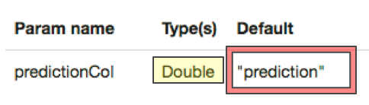
Input and Output Columns
Input Column
Output Column

Slide 7
Tree Ensembles
The DataFrame API supports two major tree ensemble algorithms:
Random Forests
Gradient-Boosted Trees (GBTs).
Tree Ensembles use spark.ml decision trees as their base models.

Slide 8
Random Forests
Random forests combine many decision trees in order to reduce the risk of overfitting.
The spark.ml implementation supports random forests for binary and multiclass classification and for regression.
They can be used for using both continuous and categorical features
Random forests train a set of decision trees separately, so the training can be done in parallel.
The algorithm injects randomness into the training process so that each decision tree is a bit different

Slide 9
Random Forest (Details)
Training
The randomness injected into the training process by subsampling the original dataset on each iteration to get a different training set Considering different random subsets of features to split on at each tree node.
Prediction
A random forest must aggregate the predictions from its set of decision trees. This aggregation is done differently for classification and regression.
Classification: Majority vote. Each tree’s prediction is counted as a vote for one class. The label is predicted to be the class which receives the most votes.
Regression: Averaging. Each tree predicts a real value. The label is predicted to be the average of the tree predictions.

Slide 10
Neural Network
Implements Multilayer Perceptron Classifier (MLPC) which is a type of Feedforward Artificial Neural Network.
MLPC used backpropogation for learning the model.
Logistic loss function can be used for calculating the loss for optimization
L-BFGS can be used as the optimization routine.

Slide 11
Neural Network
Specify layers for the neural network: # input layer of size 4 (features), two intermediate of size 5 and 4 # and output of size 3 (classes)
layers = [4, 5, 4, 3]
Create the Model and set its parameters
trainer = MultilayerPerceptronClassifier(maxIter=100, layers=layers, blockSize=128, seed=1234)
Train the model; trainData has two columns, features and label
model = trainer.fit(trainData)
Uses the transform( ) to add third column of “prediction” to the original dataframe
predictions= model.transform(testData)

Slide 12
Gradient-Boosted Trees (GBTs)
Gradient-Boosted Trees (GBTs) are ensembles of decision trees.
GBTs iteratively train decision trees in order to minimize a loss function.
The spark.ml implementation supports GBTs for binary classification and for regression,
They can be used both for continuous and categorical features.

